Slide 1
MEDICAL IMAGE ANALYSIS - PROJECT
Diabetic Retinopathy
Grading of Macular Edema Risk
in Fundus Image
EC22B1064 – B SIDDHARTH SEKHAR

Slide 2
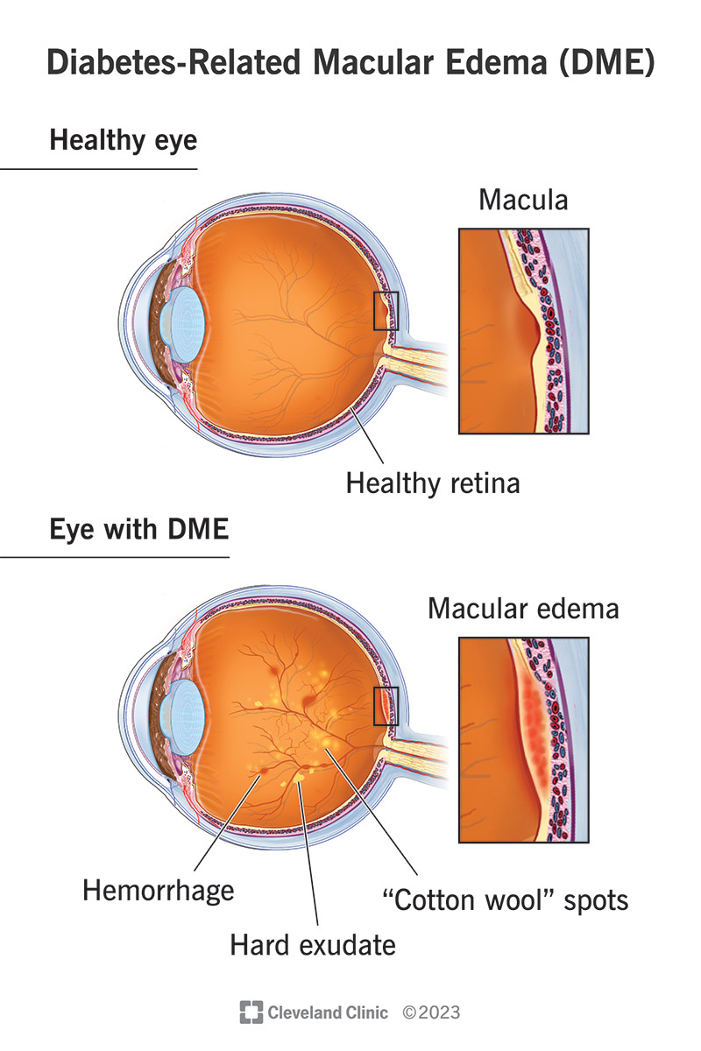
Introduction
Diabetic Retinopathy (DR) is a major cause of vision loss globally.
One severe complication is Diabetic Macular Edema (DME), caused by fluid leakage near the macula.
due excess rise in the sugar levels
Hard exudates appearing near the fovea are a key indicator of risk.
Currently, detection is done manually by clinicians, which is time-consuming and subjective

Slide 3
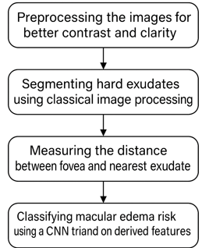
Objective:
To create an automated pipeline that detects hard exudates, calculates their distance from the fovea, and classifies the macular edema risk into three grades using a CNN.

Slide 4
Demography of dataset
The fundus images in IDRiD were captured by a retinal specialist at an Eye Clinic located in Nanded, Maharashtra, India. From the thousands of examinations available, we have extracted 516 images to form our dataset.
Experts verified that all images are of adequate quality, clinically relevant, that no image is duplicated and that a reasonable mixture of disease stratification representative of diabetic retinopathy (DR) and diabetic macular edema (DME) is present.
Images were acquired using a Kowa VX-10 alpha digital fundus camera with 50-degree field of view (FOV), and all are centered near to the macula. The images have a resolution of 4288×2848 pixels and are stored in jpg file format. The size of each image is about 800 KB.
This dataset consists of 81 color fundus images with signs of DR. Precise pixel level annotation of abnormalities associated with DR like microaneurysms (MA), soft exudates (SE), hard exudates (EX) and hemorrhages (HE) is provided as a binary mask for performance evaluation of individual lesion segmentation techniques.

Slide 5
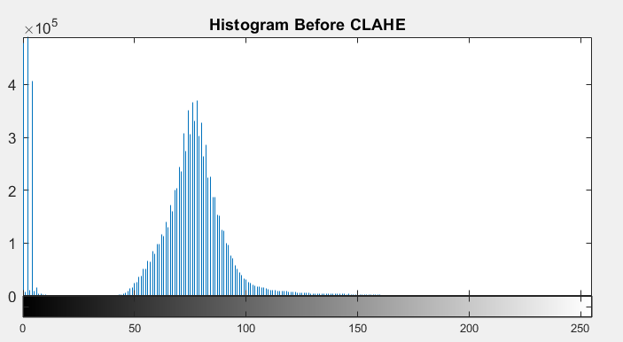
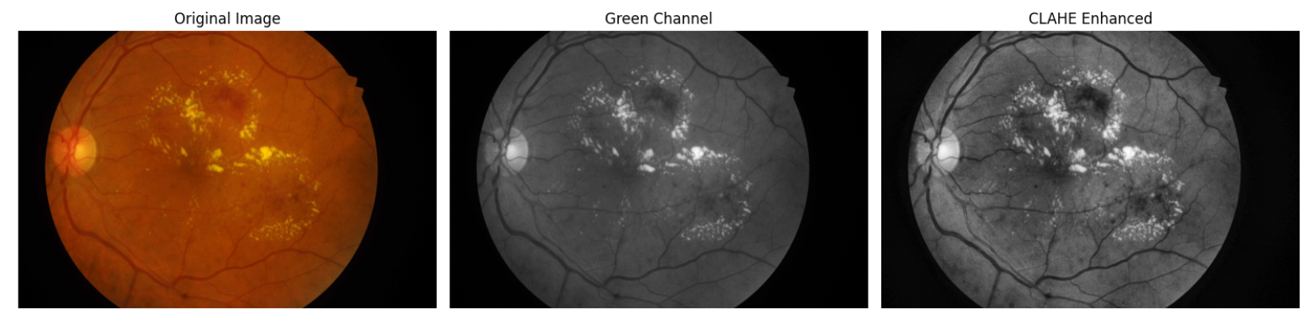
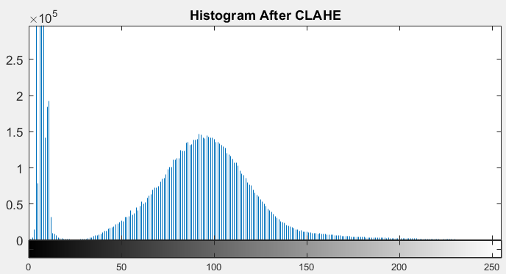
Hard Exudate Segmentation
Follows a simple approach
Begin by green channel extraction(best contrast for the lesions) and
Apply CLAHE (Contrast Limited Adaptive Histogram Equalization)

Slide 6
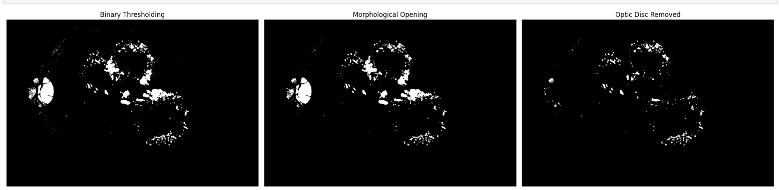
Hard Exudate Segmentation
The next steps involved are:
Threshold the image to isolate bright regions
Morphological operations to clean and separate blobs
Filter out non-exudate regions based on area and shape(Optical disk particularly)

Slide 7
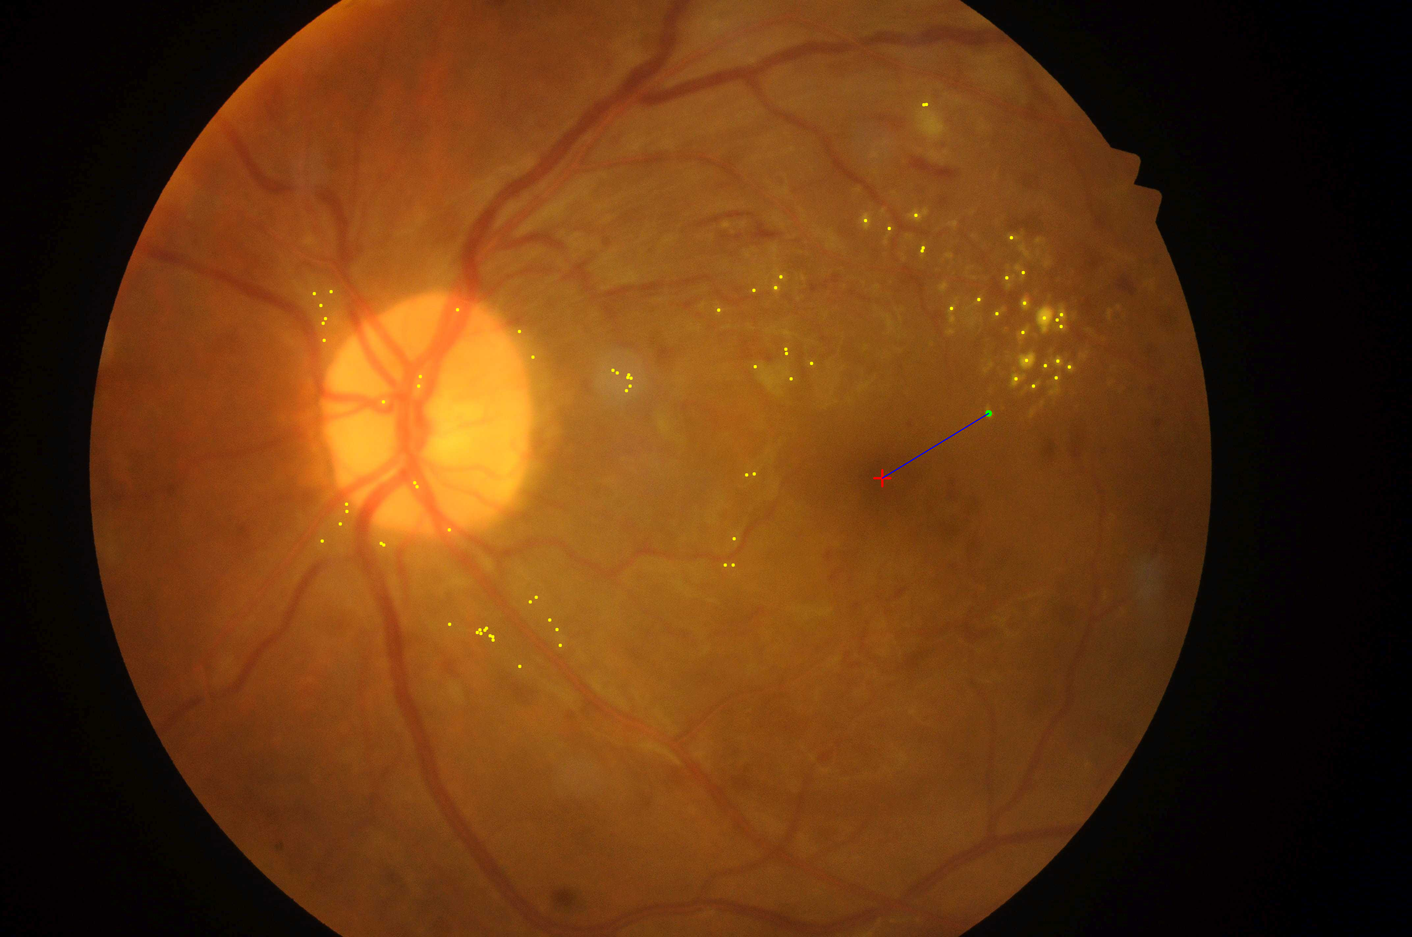
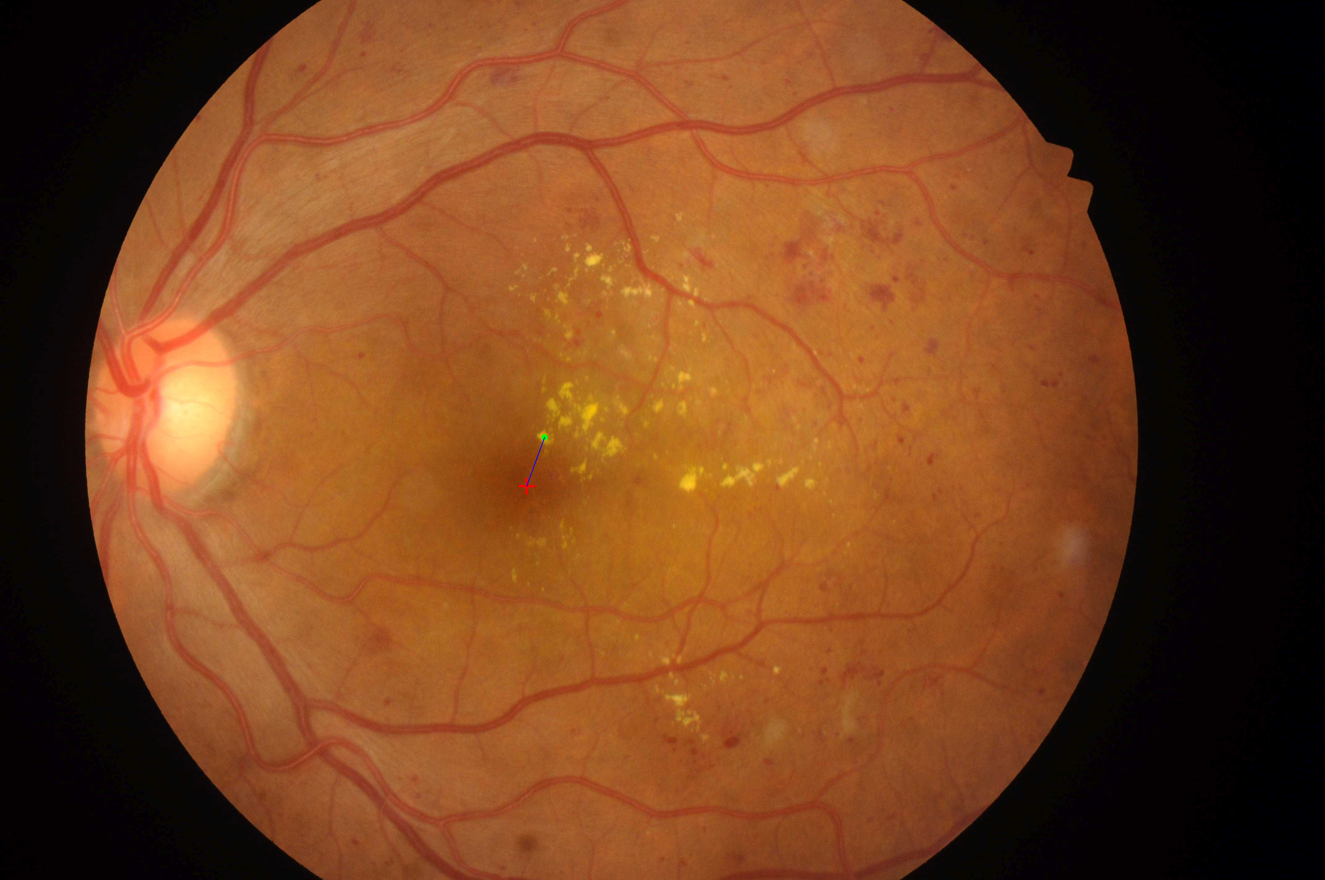
Fovea Center to Exudate Distance
The fovea coordinates are available from the dataset
For each exudate blob, compute the Euclidean distance to the fovea
The smallest distance is taken as the risk determinant
Normalized using a constant DD (diameter of optic disc), set to 200 pixels
Grading Based on Distance:
Grade 0: No exudate or far from fovea
Grade 1: Near but not close
Grade 2: Very close

Slide 8
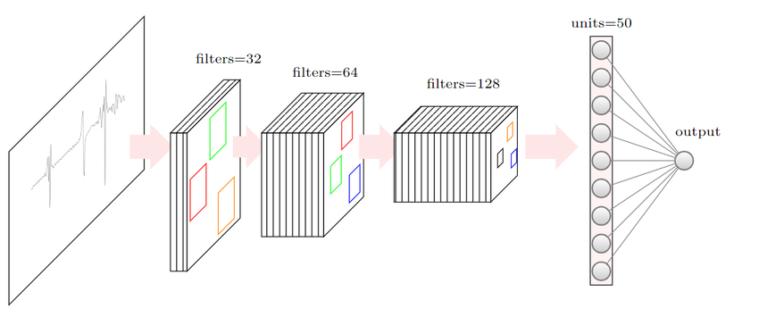
CNN Architecture for Risk Classification
Features for Grading:
Minimum fovea-to-exudate distance.
Exudate count and total area.
CNN Architecture:
Dense layers (128, 64, 32 neurons, ReLU activation).
Batch normalization and dropout (0.3) to prevent overfitting.
Softmax output for 3 classes (0: No risk, 1: Moderate, 2: Severe).
Training:
50 epochs, Adam optimizer, class-weighted loss for imbalanced data.
Augmentation (random scaling).

Slide 9
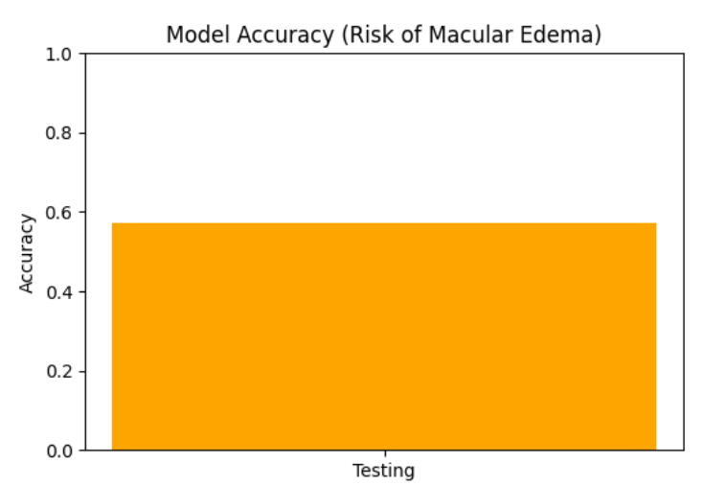

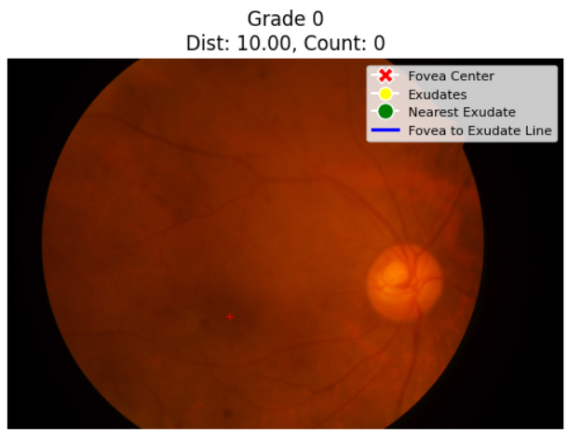
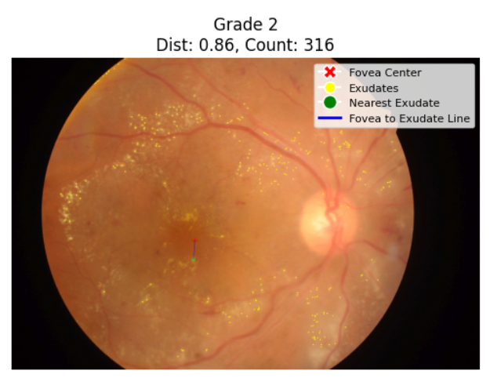
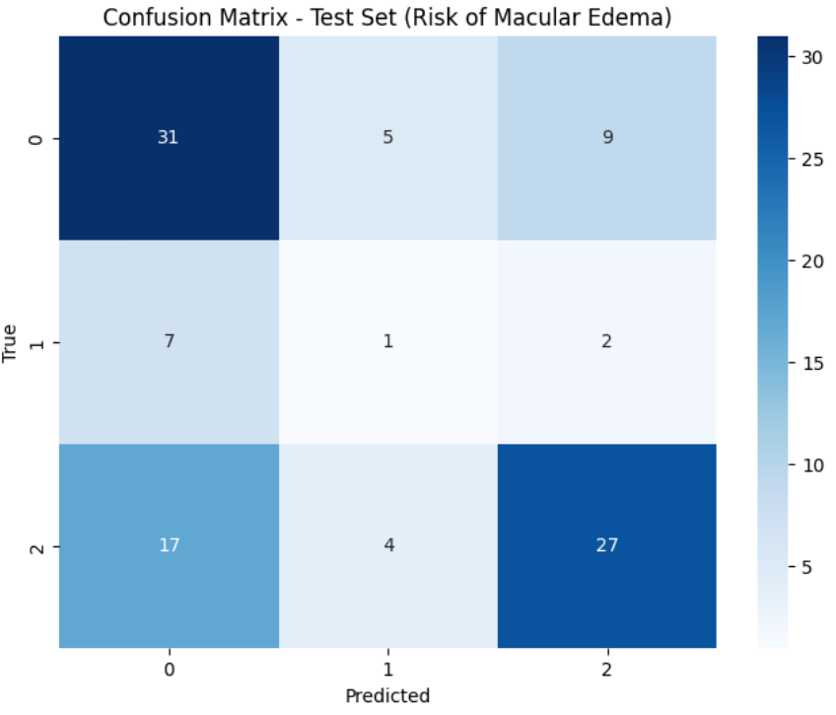
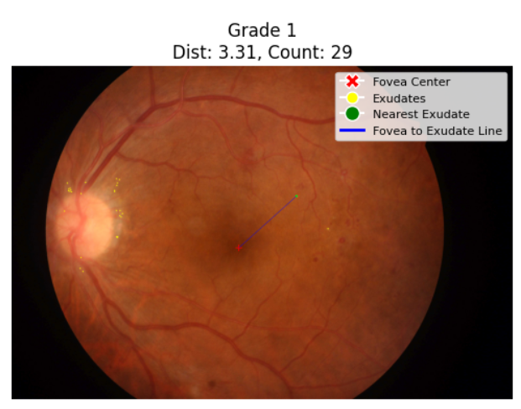
Results
CNN Performance:

Slide 10
Challenges and Limitations
Challenges:
Image Quality Variability: Inconsistent lighting in IDRiD images can affect exudate segmentation, requiring adaptive thresholding.
Optic Disc Interference: Early segmentation included the optic disc, addressed with contour filtering.
Syncing Issues: Discrepancies between precomputed and recalculated distances in visualizations needed fixes with precomputed metrics.
Limitations:
Small Dataset: 413 training images limit CNN generalization, especially with imbalanced classes.
Handcrafted Features: Focus on distance and exudate count may miss other risk factors.

Slide 11
Conclusion
Successes:
Developed an automated pipeline for grading macular edema risk using the IDRiD dataset.
Achieved reliable exudate segmentation and fovea-to-exudate distance measurement.
CNN model effectively grades risk levels with [insert test accuracy] accuracy.
Impact:
Supports scalable screening for macular edema, aiding early intervention.
Demonstrates potential for integration into clinical workflows.

Slide 12
Future Work
Enhancements:
Incorporate additional lesion types (e.g., hemorrhages, microaneurysms) for comprehensive DR grading.
Use end-to-end CNN for direct image-based classification, reducing reliance on handcrafted features.
Dataset Expansion:
Augment IDRiD with larger datasets to improve model robustness.
Clinical Integration:
Validate model with ophthalmologists and deploy in real-world screening programs. Visuals:
Roadmap graphic: Current project → Future enhancements → Clinical deployment.

